Slide 1
Applications of the RIAS-2 in PSW
There are multiple models of PSW ( e. g., Consistency-Discrepancy, Concordance-Discordance, Aptitude-Achievement Consistency).
Commonly require a measure of general cognitive skill or level (i. e., intellectual development).
Requires assessment of basic psychological processes in addition to achievement.

Slide 2
What is “Pattern of Strengths and Weaknesses?” A Quick Overview
Actual cognitive area of weakness is significantly lower than expected based on overall cognitive ability.
Cognitive deficit(s) is specific, not general or pervasive, because overall cognitive ability is at least average.
Actual academic area of weakness is significantly lower than expected based on overall cognitive ability.
Academic deficit(s) is unexpected because overall cognitive ability is at least average (and other factors were ruled out, such as inadequate instruction).
Cognitive Weakness/Deficit
Cognitive Ability or Processing Disorder
Academic Weakness/Failure
Academic Skills/Knowledge Deficits
Cognitive Strengths
Average or better overall ability, aka, g
Supported by strengths in academic skills
Performance approximately 1SD below the mean or lower (cognitive and academic areas of weakness are related empirically and relationship is ecologically valid).
Notes:
Differences between related cognitive areas of weakness or deficit and academic areas of weakness or deficit are not statistically signficant.

Slide 3
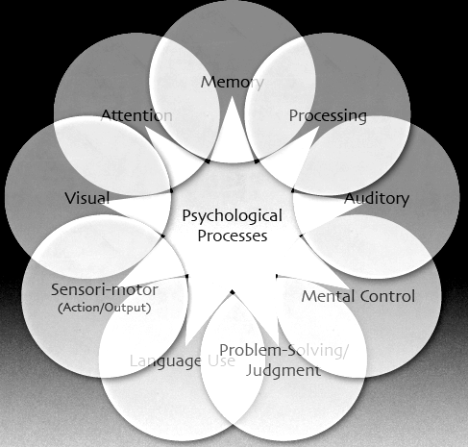
Common Psychological Processes in PSW Models

Slide 4
RIAS-2 Is a Strong, Efficient Fit to PSW Models
RIAS-2 provides the least confounded (read purest) measurement of intellectual development (i. e., g) for the largest number of students you will encounter (hence we believe it should be the intelligence test of choice in PSW models).
RIAS-2 emphasizes problem-solving in the assessment of intelligence. Problem-solving is a key psychological process in most PSW models as well and the RIAS-2 has both verbal and nonverbal (crystallized and fluid) problem-solving Indexes—the VIX and the NIX.
RIAS-2 provides you with a co-normed assessment of verbal and nonverbal memory processes.
RIAS-2 provides co-normed verbal and nonverbal processing speed tasks which are greatly motor-reduced, providing assessment of mental control, attention, and simple processing speed.
Nothing goes to waste when applying the RIAS-2 in PSW models.
All data are collected quickly and in formats most children and adolescents find engaging and fast moving, enhancing rapport and cooperation.

Slide 5
RIAS-2 and Achievement in PSW
RIAS-2 Manual provides predicted achievement scores for all 9 of the AAB indexes based on any RIAS-2 Index.
Allows direct confident and accurate comparisons of any RIAS-2 Index with these obtained achievement scores.
You can compare predicted AAB scores to obtained achievement scores on the AAB with great confidence and accuracy.
RIAS-2 correlates as well or better with achievement tests generally compared to other intelligence measures.

