Slide 1
Rivier University Education Division Specialist in Assessment of Intellectual Functioning (SAIF) Program ED 656, 657, 658, & 659 John O. Willis, Ed.D., SAIF

Slide 2
Statistics: Test Scores

Slide 3
One measurement is worth a thousand expert opinions.
.
— Donald Sutherland
A little inaccuracy sometimes saves a ton of explanation.
.
— H. H. Munro (Saki)

Slide 4
For more accurate, more detailed, and more entertaining information on these topics, please see W. Joel Schneider's Psychometrics from the Ground Up at https://assessingpsyche. wordpress.com/psychometrics-from-the-ground-up/

Slide 5
and Kevin McGrew's Applied Psychometrics at http://themindhub.com/ research-reports

Slide 6
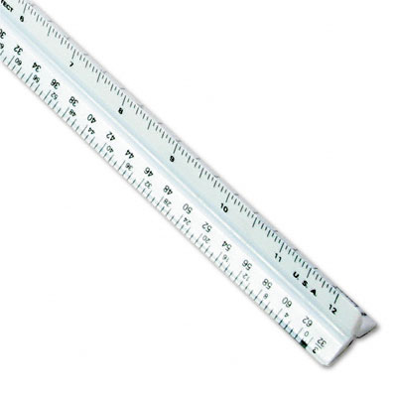
We can measure the same thing with many different units.

Slide 7
We measure the same distances with many different units.

Slide 9
We measure the same temperatures with many different units.

Slide 10
ºC
100
37
0
-17.8
ºF
212
98.6
32
0
K
373.15
310.15
273.15
255.35

Slide 11
Test authors and publishers feel compelled to do the same thing with test scores.

Slide 12
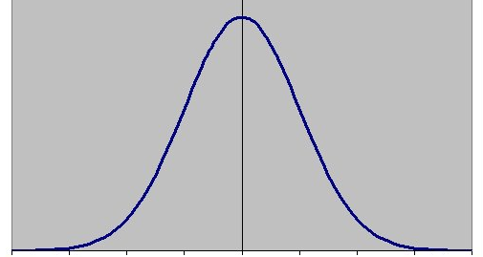
Z scores - 4 - 3 - 2 - 1 0 1 2 3 4
Standard 40 55 70 85 100 115 130 145 160
Scaled 1 4 7 10 13 16 19
V- Scale 3 6 9 12 15 18 21 24
T 10 20 30 40 50 60 70 80 90
NCE 1 1 8 29 50 71 92 99 99
Percentile 0.1 0.1 2 16 50 84 98 99.9 99.9

Slide 13
SCORES USED WITH THE TESTS When a new test is developed, it is normed on a sample of hundreds or thousands of people. The sample should be like that for a good opinion poll: female and male, urban and rural, different parts of the country, different income levels, etc.

Slide 14
The scores from that norming sample are used as a yardstick for measuring the performance of people who then take the test. This human yardstick allows for the difficulty levels of different tests. The student is being compared to other students on both difficult and easy tasks.

Slide 15
You can see from the illustration below that there are more scores in the middle than at the very high and low ends. Many different scoring systems are used, just as you can measure the same distance as 1 yard, 3 feet, 36 inches, 91.4 centimeters, 0.91 meter, or 1/1760 mile.

Slide 17
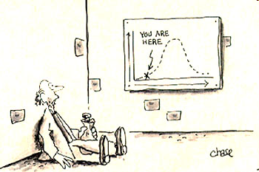

Slide 18
PERCENTILE RANKS (PR) simply state the percent of persons in the norming sample who scored the same as or lower than the student. A percentile rank of 63 would be high average – as high as or higher than 63% and lower than the other 37% of the norming sample. It would be in Stanine 6. The middle 50% of examinees' scores fall between percentile ranks of 25 and 75.

Slide 19
A percentile rank of 63 would mean that you scored as high as or higher than 63 percent of the people in the test’s norming sample ☺ and lower than the other 37 percent ☹. Never use the abbreviations “%ile” or “%.” Those abbreviations guarantee your reader will think you mean “percent correct,” which is an entirely different matter.

Slide 20
Percentile ranks (PR) are not equal units. They are all scrunched up in the middle and spread out at the two ends. Therefore, percentile ranks cannot be added, subtracted, multiplied, divided, or – therefore – averaged (except for finding the median if you are into that sort of thing).

Slide 21
NORMAL CURVE EQUIVALENTS (NCE) were – like so many clear, simple, understandable things – invented by the government. NCEs are equal-interval standard scores cleverly designed to look like percen-tile ranks. With a mean of 50 and standard deviation of 21.06, they line up with percentile ranks at 1, 50, and 99, but nowhere else, because percen-tile ranks are not equal intervals.

Slide 22
Percentile Ranks and Normal Curve Equivalents
PR 1 10 20 30 40 50 60 70 80 90 99
NCE 1 23 33 39 45 50 55 61 67 77 99
PR 1 3 8 17 32 50 68 83 92 97 99
NCE 1 10 20 30 40 50 60 70 80 90 99

Slide 23
PR
rubber band
NCE
stick

Slide 24
A Normal Curve Equivalent of 57 would be in the 63rd percentile rank (Stanine 6). The middle 50% of examinees' Normal Curve Equivalent scores fall between 36 and 64.

Slide 25
Because they are equal units, Normal Curve Equivalents can be added and subtracted, and most statisticians would probably let you multiply, divide, and average them.

Slide 26
Z SCORES are the fundamental standard score. One z score equals one stan-dard deviation. Although only a few tests (favored mostly by occupational therapists) report them, z scores are the basis for all other standard scores.

Slide 27
Z SCORES have an average (mean) of 0.00 and a standard deviation of 1.00. A z score of +0.33 would be in the 63rd percentile rank, and it would be in Stanine 6. The middle 50% of examinees' z scores fall between -0.67 and +0.67.

Slide 28
Wechsler-type STANDARD SCORES ("quotients" on some tests) have an average (mean) of 100 and a standard deviation of 15. A standard score of 105 would be in the 63rd percentile rank and in Stanine 6. The middle 50% of examinees' standard scores fall between 90 and 110.

Slide 29
[Technically, any score defined by its mean and standard deviation is a “standard score,” but we usually (except, until recently, with tests published by Pro-Ed) use “standard score” for standard scores with mean = 100 and s.d. = 15.]

Slide 30
Wechsler-type SCALED SCORES ("standard scores" [which they are] on some Pro-Ed tests) are standard scores with an average (mean) of 10 and a standard deviation of 3. A scaled score of 11 would be in the 63rd percentile rank and in Stanine 6. The middle 50% of students' standard scores fall between 8 and 12.

Slide 31
V-SCALE SCORES have a mean of 15 and standard deviation of 3 (like Scaled Scores). A v-scale score of 16 would be in the 63rd percentile rank and in Stanine 6. The middle 50% of examinees' V-Scale Scores fall between 13 and 17. V-Scale Scores simply extend the Scaled-Score range downward for the Vineland Adaptive Behavior Scales.

Slide 32
T SCORES have an average (mean) of 50 and a standard deviation of 10. A T score of 53 would be in the 62nd percentile rank, Stanine 6. The middle 50% of examinees' T scores fall between approximately 43 and 57. [Remember: T scores, Scaled Scores, NCEs, and z scores are actually all standard scores.]

Slide 33
CEEB SCORES for the SATs, GREs, and other Educational Testing Service tests used to have an average (mean) of 500 and a standard deviation of 100. A CEEB score of 533 would have been in the 62nd percentile rank, Stanine 6. The middle 50% of examinees' CEEB scores used to fall between approximately 433 and 567.

Slide 34
BRUININKS-OSERETSKY SUBTEST SCALE SCORES have an average (mean) of 15 and a standard deviation of 5. A Bruininks-Oseretsky (BOT-2) Scale Score of 17 would be in the 66th percentile rank, Stanine 6. The middle 50% of examinees' scores fall between approximately 12 and 18.

Slide 35
QUARTILES ordinarily divide scores into the lowest, antepenultimate, penultimate, and ultimate quarters (25%) of scores. However, they are sometimes modified in odd ways. DECILES divide scores into ten groups, each containing 10% of the scores.

Slide 36
STANINES (standard nines) are a nine-point scoring system. Stanines 4, 5, and 6 are approximately the middle half (54%)* of scores, or average range. Stanines 1, 2, and 3 are approximately the lowest one fourth (23%). Stanines 7, 8, and 9 are approximately the highest one fourth (23%). _________________________ * But who’s counting?

Slide 37
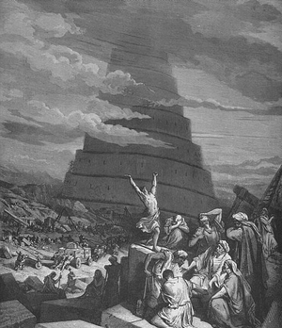
Why do authors and publishers create and select all these different scores?

Slide 38
Immortality. We still talk about “Wechsler-type standard scores” with a mean of 100 and standard deviation (s.d.) of 15. [Of course, Dr. Wechsler’s name has also gained some prominence from all the tests he published before and after his death in 1981.]

Slide 39
Retaliation? I have always fantasized that the 1960 conversion of Stanford-Binet IQ scores to a mean of 100 and s.d. of 16 resulted from Wechsler’s grabbing market share from the 1937 Stanford-Binet with his 1939 Wechsler-Bellevue and 1949 WISC and other tests.

Slide 40
My personal hypothesis was that when Wechsler’s deviation IQ (M = 100, s.d. = 15) proved to be such a popular improvement over the Binet ratio IQ (Mental Age/ Chronological Age x 100) (MA/CA x 100) there was no way the next Binet edition was going to use that score. [This idea is probably nonsense, but I like it.]

Slide 41
[Wechsler went with a deviation IQ based on the mean and s.d. because the old ratio IQ (MA/CA x 100) did not mean the same thing at different ages. For instance, an IQ of 110 might be at the 90th percentile at age 12, the 80th at age 10, and the 95th at age 14. The deviation IQ means the same thing at all ages.]

Slide 42
[The raw data from the Binet ratio IQ scores did show a mean of about 100 (mental age = chronological age) and a standard deviation, varying considerably from age to age, of something like 16 points, so both the Binet and the Wechsler choices were reasonable. However, picking just one would have made life a lot easier for evaluators from 1960 to 2003.]

Slide 43
In any case, the subtle difference between s.d. 15 and 16 (WISC 115 = Binet 116, WISC 85 = Binet 84, WISC 145 = Binet 148, etc.) plagued evaluators with the 1960/1972 and 1986 editions of the Binet. The 2003 edition finally switched to s.d. 15.

Slide 44
Matching the precision of the score to the precision of the measurement. Total or compos-ite scores based on several subtests are usually sufficiently reliable and based on sufficient items to permit a fine-grained 15-point subdivision of each standard deviation (standard score).

Slide 45
It can be argued that a subtest with less reliability and fewer items should not be sliced so thin. There might be fewer than 15 items! A scaled score dividing each standard deviation into only 3 points would seem more appropriate, but there are consequently big jumps between scores on such scales.

Slide 46
The Vineland Adaptive Behavior Scale v-scale extends the scaled score measurement downward another 5 points to differentiate among persons with very low ratings because the Vineland is often used with persons who obtain extremely low ratings. The v-scale helpfully subdivides the lowest 0.1% of ratings.

Slide 47
T scores, dividing each standard deviation into 10 slices, are finer grained than scaled scores (3 slices), but not quite as narrow as standard scores (15). The Differential Ability Scales, Reynolds Intellectual Assessment Scales, and many personality and neuropsychological tests and inventories use T scores.

Slide 48
Dr. Bill Lothrop often quoted Prof. Charles P. "Phil" Fogg: Gathering data with a rake and examining them under a microscope. Test scores may give the illusion of greater precision than the test actually provides.

Slide 49
However, Kevin McGrew (http://www.iapsych.com/iapap101/iap101brief5.pdf) warns us that wide-band scores, such as scaled scores, can be dangerously imprecise. For example a scaled score of 4 might be equivalent to a standard score of 68, 69, or 70 (the range usually associated with intellectual disability) or 71 or 72 (above that range).

Slide 50
That lack of precision can have severe consequences when comparing scores, tracking progress, and deciding whether a defendant is eligible for special education or for the death penalty (http://www.atkinsmrdeath penalty.com/).

Slide 51
The WJ IV, KTEA-II, and WIAT-III, for example use standard scores with Mean 100 & SD 15 for both (sub)tests and composites. This practice does not seem to have caused any harm, even if it is unsettling to those of us who trained on the 1949 WISC and 1955 WAIS.

Slide 52
Sometimes test scores offer a special utility. The 1986 Stanford-Binet Fourth Ed. (Thorndike, Hagen, & Sattler), used composite scores with M = 100 and s.d. = 16 and subtest scores with M = 50 and s.d. = 8.

Slide 53
With that clever system, you could convert subtest scores to composite scores simply by doubling the subtest score. It was very handy for evaluators. Mentally converting 43 to 86 was much easier than mentally converting scaled score 7 or T score 40 to standard score 85.

Slide 54
Sample Explanation for Evaluators Choosing to Translate all Test Scores into a Single, Rosetta Stone Classification Scheme [In addition to writing the following note in the report, remind the reader again in at least two subsequent footnotes. Readers will forget.]

Slide 55
“Throughout this report, for all of the tests, I am using the stanine labels shown below (Very Low, Low, Below Average, Low Average, Average, High Average, Above Average, High, and Very High), even if the particular test may have a different labeling system in its manual.”

Slide 56
Stanines

Slide 57
Obviously, that explanation is for translating all scores into stanines. You would modify the explanation if you elected to translate all scores into a different classification scheme, such as that used with the Woodcock-Johnson. (Boiler plate is always risky in reports!)

Slide 58
Sample Explanation for Evaluators Using the Rich Variety of Score Classifications Offered by the Several Publishers of the Tests Inflicted on the Innocent Examinee.

Slide 59
“Throughout this report, for the various tests, I am using a variety of different statistics and different classification labels (e.g., Poor, Below Average, and High Average) provided by the test publishers. Please see p. i of the Appendix to this report for an explanation of the various classification schemes.”

Slide 60
Standard Score 110

Slide 61
My score is 110! I am adequate, average, high average, or above average. I’m glad that much is clear!

Slide 65
Very Low
Very High
Very Low – 54
WISC-V

Slide 66
It is essential that the reader know (and be reminded) precisely what classification scheme(s) we are using with the scores, whether we use all the different ones provided with the various tests or translate everything into a common language.

Slide 67
I usually put all my test scores in an appendix to the narrative report. The right-most column is usually a verbal label for each score (e.g., “Above Average”). I use footnotes to explain the test scores, confidence bands, and percentile ranks in at least the first table in the appendix.

Slide 68
The last column gets a footnote in every table so I can keep reminding the reader that I am either using one set of verbal labels (not necessarily the publisher’s) for scores or that I am using various publishers’ different sets of labels, so the same score may have different names.

Slide 70
1. These are the standard, scaled, or T scores used with the various tests. Please see p. i of the Appendix to this report for an explanation of these scores. 2. Even on the best tests, scores can never be perfectly accurate. This range shows how much scores are likely to vary 90% of the time just by pure chance. 3. Percentile ranks tell the percentage of students the same age who scored the same as Ralph or lower. For example, a percentile rank of 67 would mean that Ralph scored as high as or higher than 67 percent of students his age and lower than the remaining 33 percent.

Slide 71
4. Each test uses its own particular scheme for classifying scores. The same score may be called different names on different tests. Please see the explanation on p. i of the Appendix to this report. – or – 4. Each test uses its own particular scheme for classifying scores. The classification schemes for the various tests taken by Ecomodine are explained on p. ii. I have taken the liberty of substituting "stanine" classifications, as explained on p. i, for the publishers' classifications. These are NOT the classification labels used by the various test publishers. Please see p. ii.

Slide 72
If, as I usually do, I copy and paste parts of tables into my narrative (perhaps deleting some rows and columns), I again footnote all columns in the first table and footnote the verbal label column in all tables.

Slide 73
No matter what you do, you will confuse some readers, annoy others, and enrage a few.
Explain what you are doing in at least three places in the narrative and in a footnote on every table and a few score citations in text.

Slide 74
However, bear in mind that all such classification schemes are arbitrary (not, as attorneys say, “arbitrary and capricious,” just arbitrary).

Slide 75
"It is customary to break down the continuum of IQ test scores into categories. . . . other reasonable systems for dividing scores into qualitative levels do exist, and the choice of the dividing points between different categories is fairly arbitrary. . . .

Slide 76
“It is also unreasonable to place too much importance on the particular label (e.g., 'borderline impaired') used by different tests that measure the same construct (intelligence, verbal ability, and so on)." [Roid, G. H. (2003). Stanford-Binet Intelligence Scales, Fifth Edition, Examiner's Manual. Itasca, IL: Riverside Publishing, p. 150.]

Slide 77
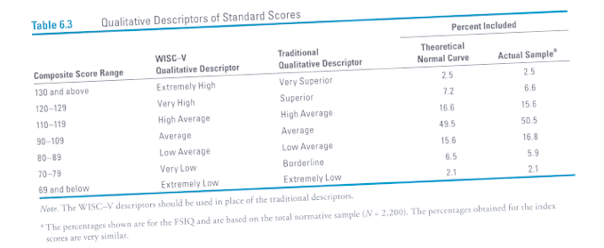
Page 153
"Qualitative descriptors are only suggestions and are not evidence-based; alternate terms may be used as appropriate" [emphasis in original].
[WISC-V Technical and interpretive manual, p. 152.]

Slide 78
Life becomes more complicated when scores are not normally distributed, as is often the case with neuropsychological tests and behavioral checklists, and sometimes with visual-motor and language measures.

Slide 79
It is easy to check. In a normal distribution (or one that has been brutally forced into the Procrustean bed of a normal distribution), the following scores should be equivalent.

Slide 80
If the standard scores do not match these percentile ranks in the norms tables, the score distribution is not normal and the standard scores and percentile ranks must be interpreted separately. See the test manual and other books by the test author(s).

Slide 81
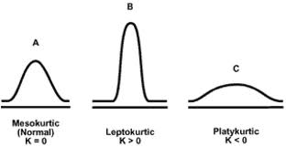

Slide 82
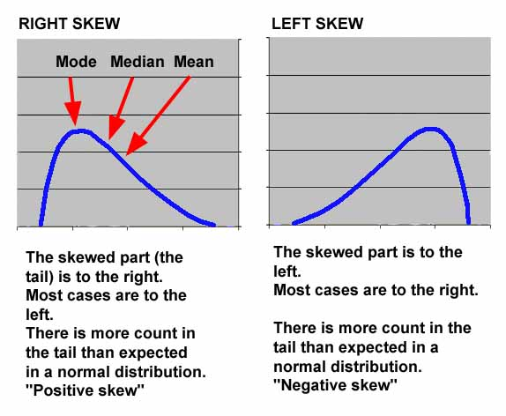
http://myweb.stedwards.edu/brianws/3328fa09/sec1/lecture11.htm
Brian William Smith

Slide 83
Dumont/Willis Extra Easy Evaluation Battery
(DWEEEB)
http://www.myschoolpsychology.com/Humor.pdf
http://www.myschoolpsychology.com/wp-content/uploads/2014/02/DWEEEB.pdf

Slide 87
A publisher calling a score “average” does not make the student’s performance average. If a student earned a Low Average reading score of 85 on the KTEA or WIAT-II and is then classified as Average for precisely the same score on the KTEA-II or WIAT-III, the student is still in the bottom 16% of the population!

Slide 88
HAND ME THAT GLUE GUN
Byron Preston, 15, hasn't gone to school for four months. . . . He . . . was expelled for possession of a "weapon" -- a tattoo gun, which he took to school to practice tattooing on fruit. "It doesn't shoot anything," complains his father, James. "It just happens to have the word 'gun'." But school officials wouldn't listen, saying a student having a "gun" at school calls for automatic expulsion according to their zero tolerance policy. A Prince George's County Public Schools spokesman says the policy is "under review" by the school board. The Prestons have been told verbally that they won the appeal of the expulsion, but somehow the paperwork to reinstate Byron into school has never shown up. (RC/WTTG-TV)

Slide 89
I call 90 - 109 “Average.”

Slide 90
I call 85 - 115 “Average.”

Slide 91
I call 80 - 119 “Average.”

Slide 92
I call him “Nice Kitty.”

