Slide 1
ANNUAL PROGRESS: MAINTAINING THE SAME RELATIVE POSITION A Year’s Growth in a Year’s Time?

Slide 2
Grade-Equivalent Scores Corresponding to Standard Scores of 120, 110, 100, 90, and 80 by Spring Grade Norms

Slide 3
KTEA-II Form A Reading Comprehension Alan Kaufman & Nadeen Kaufman. Circle Pines, MN: Pearson Assessment, 2004 Analogy with a Four-Lap, One-Mile Footrace

Slide 4
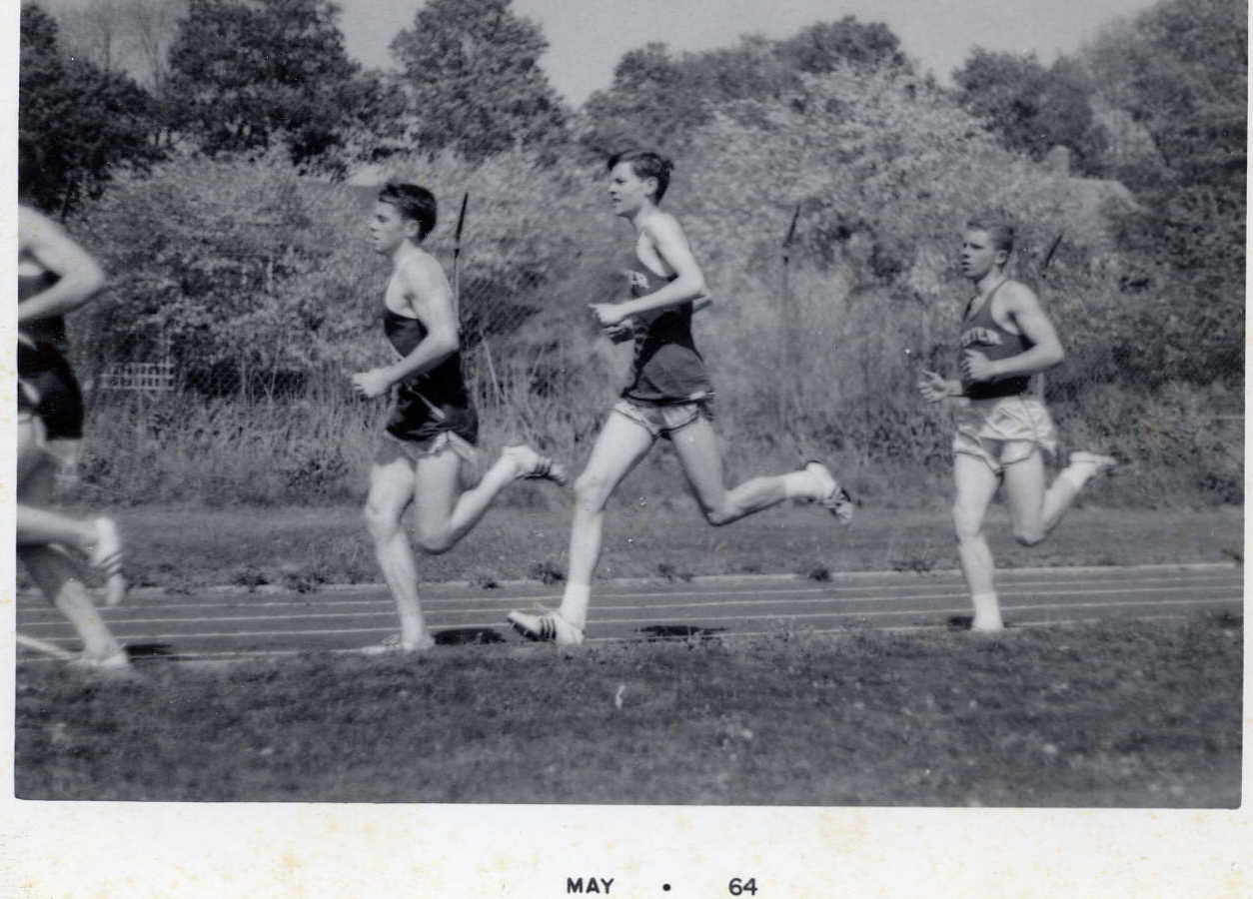
Ron Dumont & John Willis 2/28/07 Revised by Susan Morbey 11/25/07 Analogy stolen from Gerald M. Zelin, Esq. (but experienced by John Willis running against Olympic Gold Medalist Frank Shorter et al. c. 5/2/64)

Slide 5
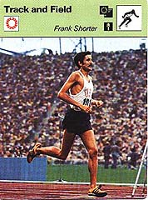

Slide 6
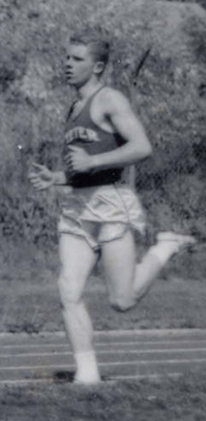
Ed. Evals. 5/15/09
Ron Dumont & John Willis
6
Notes:
6

Slide 7
SS = Standard Score PR = Percentile Rank GE = Grade-Equivalent Score Note: Grade-Equivalent Scores are not equal units. You cannot add or subtract them as we have done here! Don’t do that! 1 mile = 4 laps around track

Slide 8
4 laps = 1 mile
1 lap = 1 year of school
4 laps = grades 1 through 4

Slide 9
BANG!

Slide 11
End of First Lap
End of first grade (grade 1.9).
Red (Shorter) is in first place (grade equivalent 3.2).
Blue, Violet, and Turquoise are in second, third and fourth places.
Green (Willis) is in last place (grade equivalent 1.0).
Shorter is already 2.2 grades ahead of Willis [3.2 – 1.0 = 2.2].

Slide 13
Note: Grade-Equivalent Scores are not equal units. You cannot add or subtract them as we have done here! Don’t do that! International Reading Association (1982). Misuse of grade equivalents: resolution passed by the Delegates Assembly of the International Reading Association, April 1981. Reading Teacher, January, p. 464. Smith, M. III (2009). The Hippocratic Oath and grade equivalents (Metametrics Position Paper 1330L). Retrieved from http://www.lexile.com/m/uploads/grade-equivalents/HippocraticOathGradeEquivalents.pdf Willis, J. O. (1977). Overall Achievement Test - Cumulative Evaluation Reflecting Educational Ability Level (OAT-CEREAL). NH Personnel and Guidance Journal, 6, 1, 9.

Slide 14
End of Second Lap
End of grade two (grade 2.9).
Red (Shorter) is still in first place (grade equivalent 4.9).
Blue, Violet, and Turquoise are still in second, third and fourth places.
Green (Willis) is still in last place (grade equivalent 1.5).
Shorter is now 3.4 grades ahead of Willis [4.9 – 1.5 = 3.4].

Slide 16
End of Third Lap
End of grade three (grade 3.9).
Red (Shorter) is still in first place (grade equivalent 6.5).
Blue, Violet, and Turquoise are still in second, third and fourth places.
Green (Willis) is still in last place (grade equivalent 2.0).
Shorter is now 4.5 grades ahead of Willis [6.5 – 2.0 = 4.5].

Slide 18
End of Fourth Lap
End of grade four (grade 4.9).
Red (Shorter) is still in first place (grade equiv. 7.5) and has finished.
Blue, Violet, and Turquoise are still in second, third and fourth places.
Green (Willis) is still in last place (grade equiv. 2.4) and is still running.
Shorter is now 5.1 grades ahead of Willis [7.5 – 2.4 = 5.1].

Slide 19
Four Laps = 1 Mile
We all made some progress each year. Each of us completed each lap and covered more or less another quarter-mile.
We all kept the same relative positions. Shorter (Red) remained in front with Standard Score 120. Violet remained in the middle with Standard Score 100, and Willis (Green) was always fifth with Standard Score 80.

Slide 20
Four Laps = 1 Mile
However, after each lap, as average Violet passed the end-of-lap mark, Shorter (Red) moved farther ahead of average (Violet) and much farther ahead of below-average Willis (Green).

Slide 22
Note: Grade-Equivalent Scores are not equal units. You cannot add or subtract them as we have done here for this illustration! Don’t do that!

Slide 23
Maintaining the same standard score does mean maintaining the same relative position in your group.
If that standard score is 100 (scaled score 10, T score 50, percentile rank 50, NCE 50, etc.), then you are making about one year’s progress each year and maintaining the same relative position.

Slide 24
If that standard score is less than 100 (scaled score 10, T score 50, percentile rank 50, NCE 50, etc.), then you are making less than one year’s progress each year and maintaining the same relative position.

Slide 25
We are here defining “one year’s progress” as the average progress measured by a normed test over one year for a student achieving precisely average scores.
That amount is also 1.0 years of grade equivalencies.
Grade-equivalent scores are not equal units.

Slide 26
If that standard score is greater than 100 (scaled score 10, T score 50, percentile rank 50, NCE 50, etc.), then you are making more than one year’s progress each year and maintaining the same relative position.

Slide 27
Final Caveats
Grade-equivalent scores become ever less meaningful as students progress through the grades.
Grade-equivalent scores are not equal units, so they cannot be added, subtracted, multiplied, nor divided (which pretty much eliminates averaging). If one insists, one may find the median.

Slide 28
Final Caveats
The average student’s basic reading, writing, and math skills do not improve dramatically in high school.
However, high-school students with weak basic reading, writing, and math skills can (and, we believe, absolutely should be taught to) increase the levels of those skills.

Slide 29
Final Caveats
Most individually administered achievement tests do not deeply test the specialized, advanced skills mastered by the average student during high school.
Work samples; classroom tests; examiner-made criterion-referenced tests; curriculum-based assessment (CBA or CBM); and collaboration with teachers may be needed.

Slide 30
Final Caveats
Many teaching programs include lists of specific skills to be taught. Some even include end-of-unit tests or other criteria for demonstrating mastery. These can be used (or adapted to be used) as one way of measuring progress if the specific skills are defined with sufficient clarity and specificity.

Slide 31
Note: Grade-Equivalent Scores are not equal units. You simply cannot add or subtract or average them as we have done here for this illustration! Don’t do that!

