Slide 1
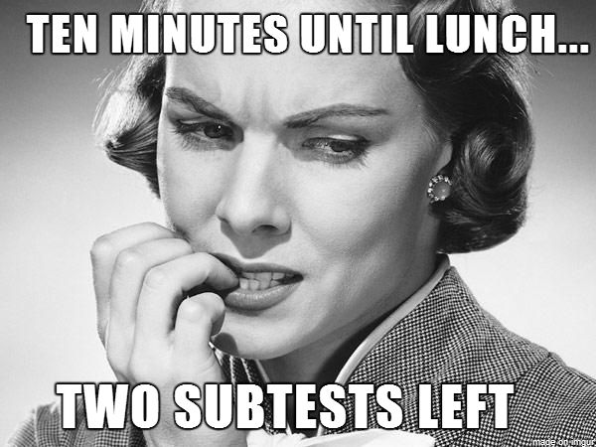

Slide 2
And one of those lessens might be spelling. It's never too late.

Slide 4
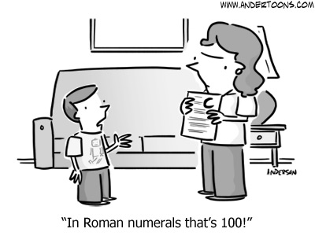
"In Roman numerals that's 100!"

Slide 6
"Lassie, get tech support."

Slide 9
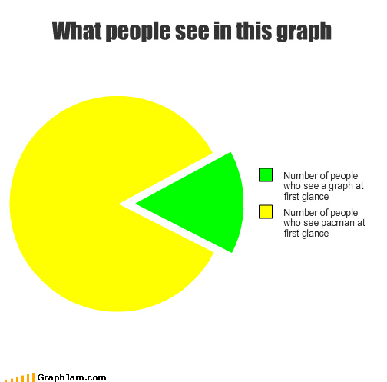
How do you present the results?
Number of people who
see a graph at first glance.
Number of people who see Pac-Man at first glance.

Slide 10
John Willis:
"Duh . . . yes! Do you think I'm clueless?"

Slide 11
And one of those lessens might be spelling. It's never too late.

Slide 13
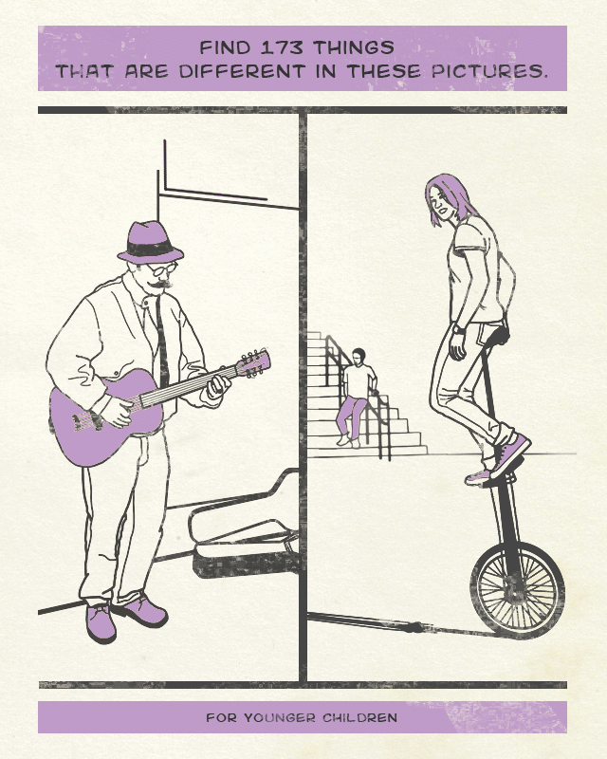

Slide 14
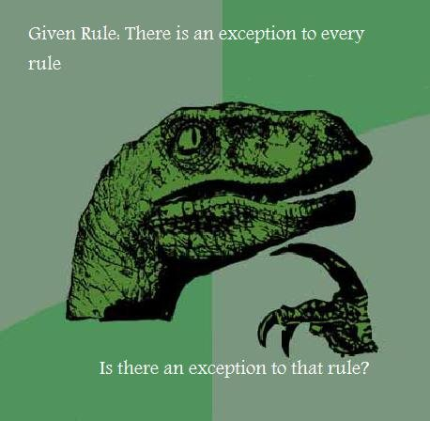

Slide 15
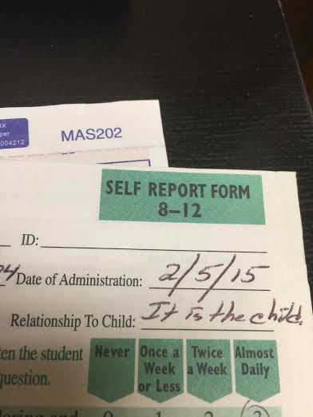
Brown ADHD Scales-Self Form

Slide 16
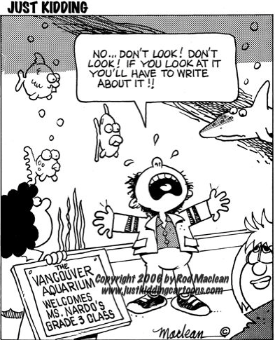

Slide 17
Lisa Donnelly
The New Yorker
10/13/14
"It was your first day—
why not give it another twelve years?"

Slide 19
.
When I was young, we
didn't need help finding
the floor. You just fell
down, and there it was.

Slide 20
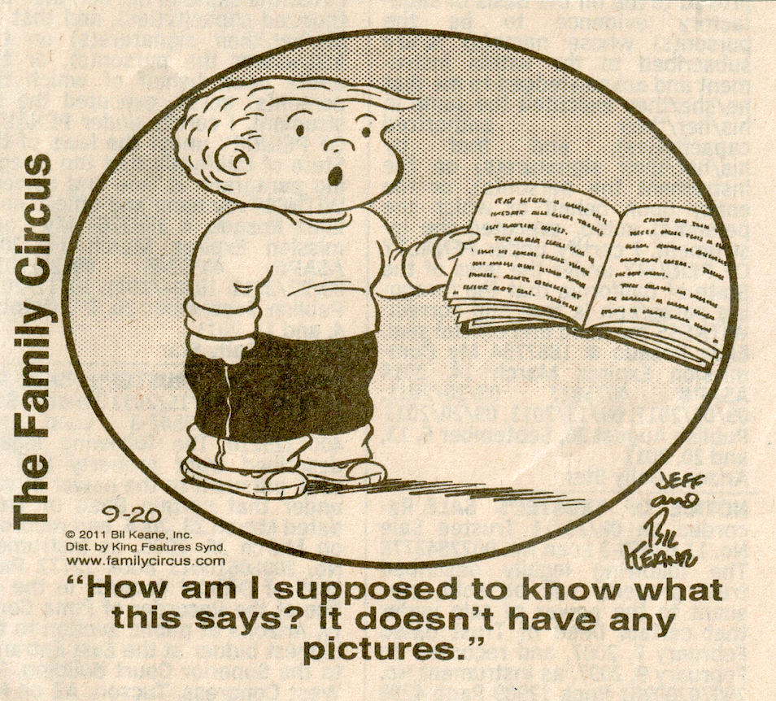

Slide 21
"I don't think my brain has any more room left to learn stuff."

Slide 22
A computer once beat me at chess, but it was no match for me at kick boxing. – Emo Philips

Slide 25
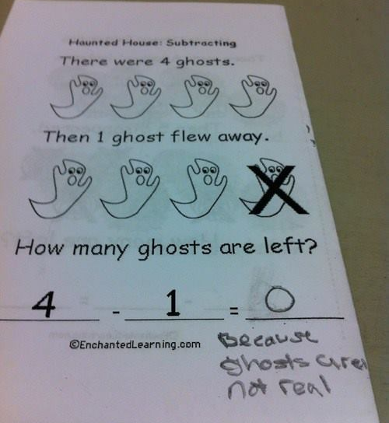

Slide 26
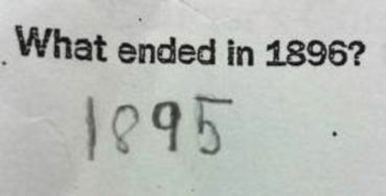

Slide 27
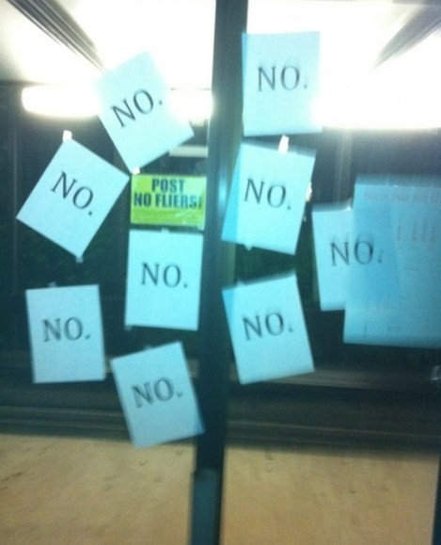

Slide 28
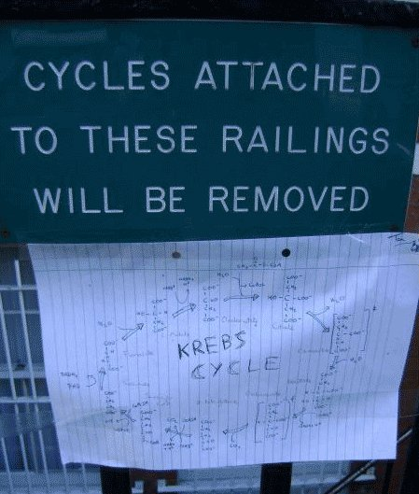

Slide 29
A Note on Terminology
Most standardized tests attempt to present items in an approximate order from easier to more difficult (or no-brainer to impossible).
Item numbers follow this approximate sequence of increasing difficulty. Item 13 is intended to be easier than Item 14. Item 13 very probably is easier than Item 23 for most examinees.
However, items are printed on the Test Record vertically with the easiest items at the top and the most difficult at the bottom.

Slide 30
A Note on Terminology
1. Items probably easier than the Below
2. current item: before or below (??)
3. or lower-numbered than the
4. current item.
5. Current Item
6. Items probably harder than the
7. current item: after or above (??)
8. or higher-numbered than the
9. current item. Above
. What's up with that?

Slide 31
GULLIBLE
http://discoverymagazineus.com/elite/report.html

Slide 32
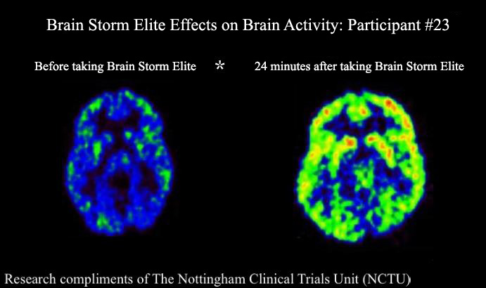
http://www.brainstormelite.com/

Slide 33
Diagnosis by Checklist
John Willis discovered that diagnosis by checklist can be misleading. While reading a magazine in a waiting room, he completed a checklist very similar to the following one.

Slide 34
TAKE THIS QUIZ TODAY!
Mood Swings, Emotional Outbursts, Irritable ✓
Chronic Fatigue, Extreme Fatigue, Feel Drained ✓
Poor Concentration and Memory, Spaced out Feeling ✓
Muscle Aches, Weakness or Paralysis ✓
Pain or Swelling in Joints ✓
Vaginal Burning, Itching, Discharge .
PMS, Cramps and Menstrual Irregularities.
Anxiety Attacks, Panic Attacks, Chronic High Stress ✓
Headaches or Migraines ✓
10. Chronic Indigestion, Frequent use of Antacids ✓
If you have at least 6 of these 10 symptoms, you probably have a vaginal yeast infection and should ask your doctor about Candidakill.™

