Slide 1
No!
Tough place to spend your probation!

Slide 2
Sometimes, the most brilliant and intelligent minds do not shine in standardized tests because they do not have standardized minds.
– Diane Ravitch

Slide 3
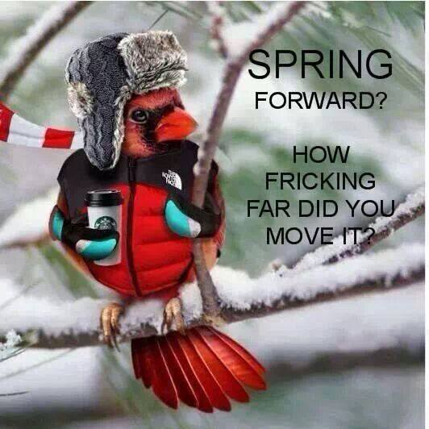

Slide 4
www.perpetualkid.com

Slide 7
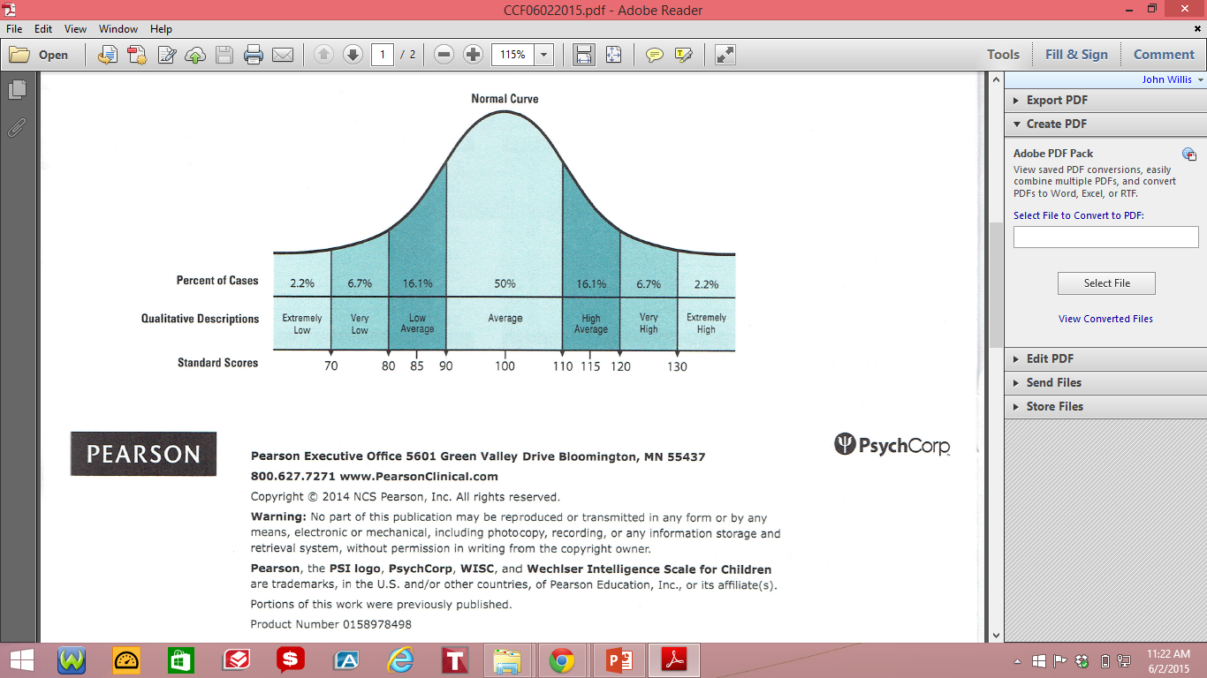

Slide 11
Every one in four people in the U.S. has a diagnosable mental illness. You will be surprised to know that every family you know may have a member who might be considered "different," "specíal" or is being treated for a mental condition. What if you are called upon to mitigate a crisis situation involving a personal with a mental condition in the workplace? If you don't handle the situation with proper knowledge and skills, it can not only cost physícal injuries but thousands of dollars to your organization or community for perceived negligence. | Live Webinar Thursday, July 23, 2015 Duration : 60 minutes 1:00 pm ET 12:00 pm CT Register Now

Slide 12
Every one in four people in the U.S. has a diagnosable mental illness. You will be surprised to know that every family you know may have a member who might be considered "different," "specíal" or is being treated for a mental condition. What if you are called upon to mitigate a crisis situation involving a personal with a mental condition in the workplace? If you don't handle the situation with proper knowledge and skills, it can not only cost physícal injuries but thousands of dollars to your organization or community for perceived negligence. | Live Webinar Thursday, July 23, 2015 Duration : 60 minutes 1:00 pm ET 12:00 pm CT Register Now
If you have three friends who do not have diagnosable mental illnesses, then it is probably you.

Slide 13
50+
people
50, a person's glucose
50+

Slide 14
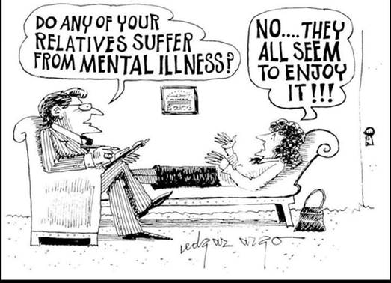

Slide 15
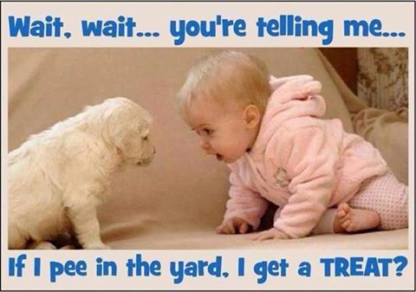

Slide 16
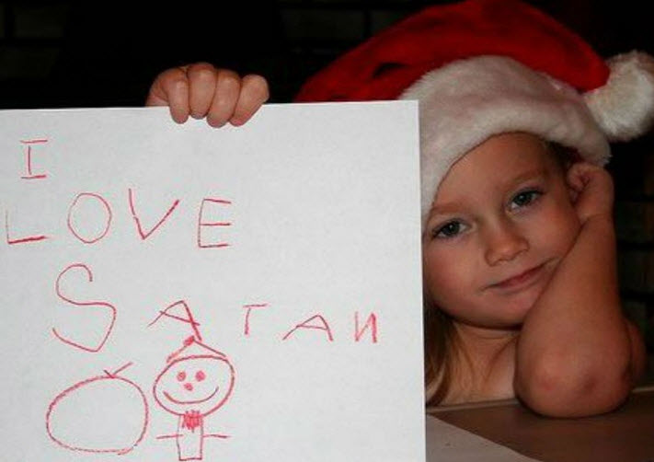

Slide 18
The Automatic Tile Shuffling Mahjong Table.
Item 12673
Price $1,700
How Many?
Perfect for the teachers' room.

Slide 19
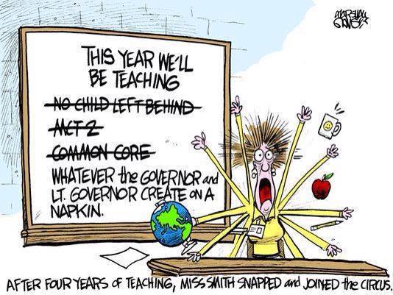

Slide 20
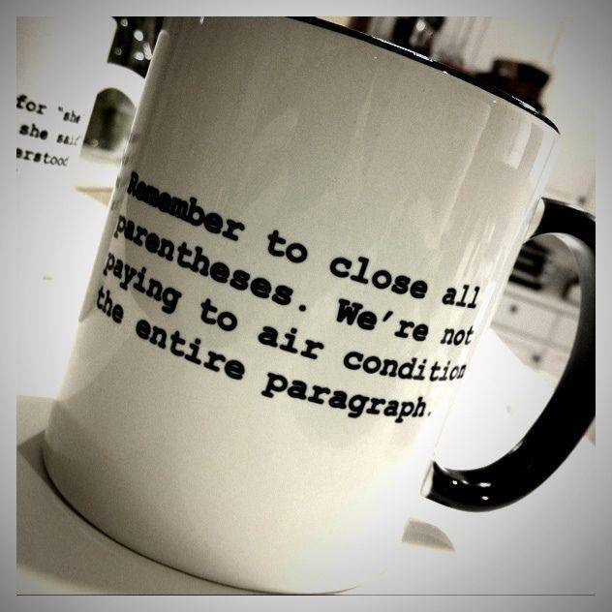
Remember to close all parentheses. We're not paying to air condition the entire paragraph.

Slide 21
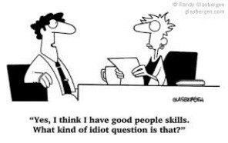

Slide 24
"Remember, education pays,
unless you end up an adjunct—like me."
Barbara Smaller, The New Yorker, 9/21/15

Slide 25
"It's interpret-your-own-test-results day today."

Slide 26
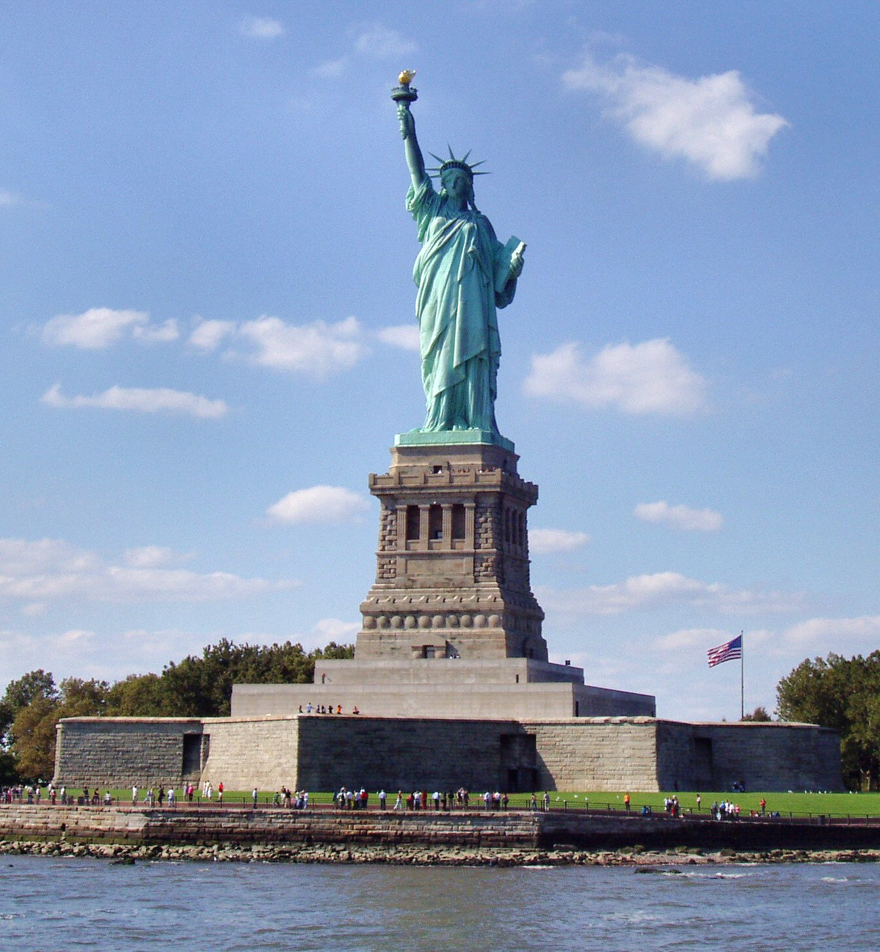
James M. Inhofe National Park 2015

Slide 27
James M. Inhofe National Park 2065

Slide 29
You're in America
now. You need to speak English. If you want to
speak Mexican, go
back to Mexico.
Hágoónee’. Nizhónígo Nee Ado’ááł.
Sir, I was speaking
Navajo. If you want to
speak English, go back
to England.

Slide 30
Message sent from NYASP Convention 10/23/15.

Slide 31
"I'm staying together for the sake of my parents."

Slide 32
"The Office of Special Education and Rehabilitation Services (OSERS) has received communications from stakeholders."
stakeholder

Slide 33
If I knew the ZIP™ Code, why would I be looking it up?

Slide 34
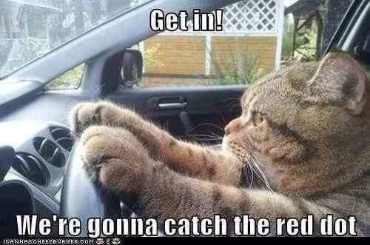

Slide 35
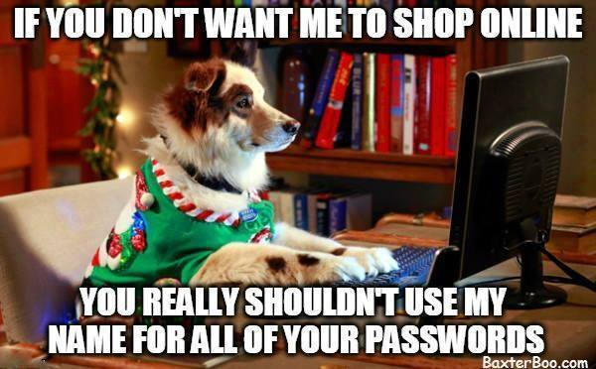

Slide 36
