Slide 1
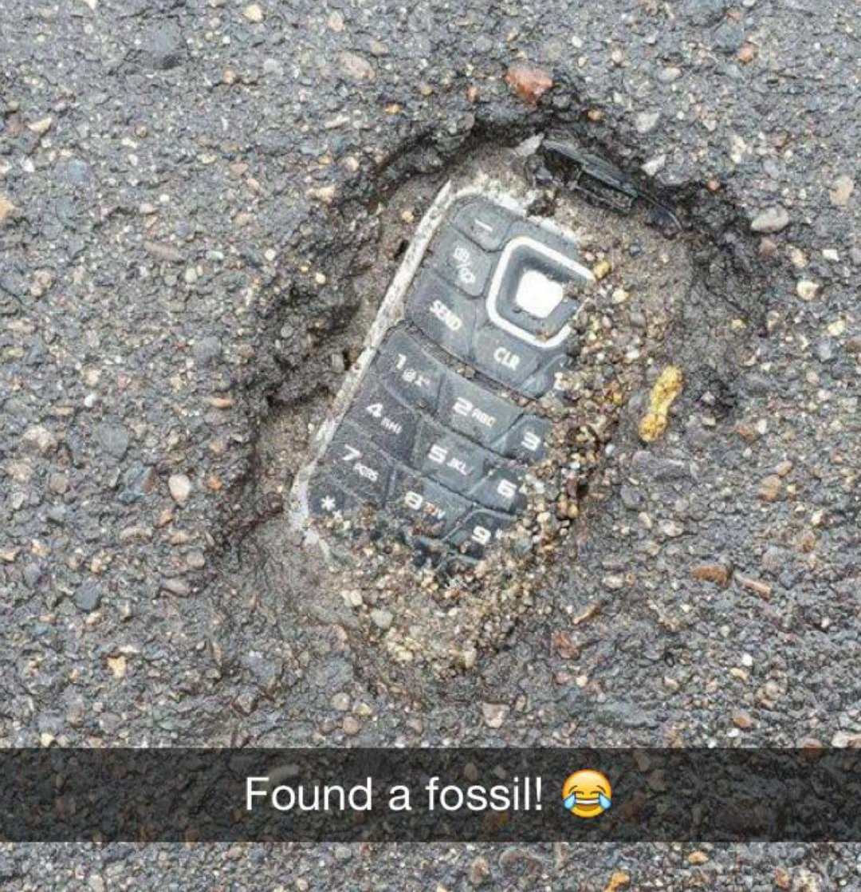
John's flip phone

Slide 2
OK, I guess that, after 2016 years, it really is time for me to retire.

Slide 3
To look up the ZIP Code, please enter the ZIP Code here and tap "Find."

Slide 4
I don't remember your name, either.

Slide 6
This is the Burial Slab of Jesus Christ?

Slide 7
When writing recommend-dations, do not omit the obvious. They may not be obvious to everyone.

Slide 8
2 + 2 = 5
ALTERNATIVE FACT

