Slide 1
IQ Tests Are Not Interchangeable
The issue of using IQ tests in the process of diagnosing intellectual and developmental disabilities takes on special importance when eligibility for the death penalty is being considered. The following artificial, contrived, and extreme, but statistically accurate, example illustrates the important fact that different IQ tests with high reliability and validity will not always give the same or even similar scores to an individual.

Slide 2
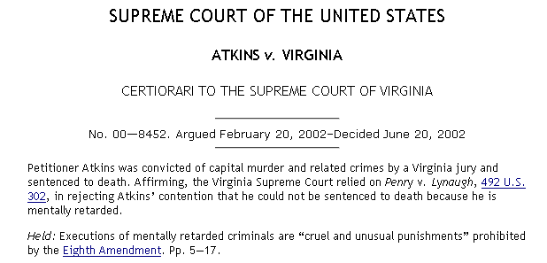

Slide 3
Sam Adkins, age 16, (apocryphal and therefore no relation to Daryl Atkins), has been convicted of murder by a jury of his peers. In order to determine the appropriate sentence (Life Imprisonment or Death), and because of the United States Supreme Court decision in Atkins v. Virginia, the court has requested that Sam’s intellectual ability be assessed by experts in the field using the most modern cognitive measures.

Slide 4
A review of Sam’s educational history suggests that he may have a severe learning disability reflected in extremely low auditory (Ga), short-term and working memory (Gsm), long-term storage and retrieval (Glr), processing speed (Gs), and math abilities (Gq).

Slide 5
In fact, Sam has precisely average (standard score ≈ 100) verbal (Gc), spatial (Gv), and fluid reasoning (Gf) abilities. His severe learning disability is reflected in extremely low (standard score ≈ 50) auditory (Ga), short-term and working memory (Gsm), long-term storage and retrieval (Glr), processing speed (Gs), and math (Gq) abilities.

Slide 6
(Without those severe and pervasive processing disorders, Sam's Gc, Gv, and especially Gf scores might be considerably higher.) However, given the abilities listed above, the following are Sam's scores on seven cognitive ability measures. Not all tests measure the seven broad abilities we are considering, so there are blanks.

Slide 7
Sam's Total Scores (GIA, FSIQ, GCA,
CIX, FCI, or MPC) on Seven Tests
Several tests, especially the DAS-II, have additional subtests that are not included in the total score.

Slide 9
Because various intelligence tests measure and omit different abilities, any one individual may receive, as did Sam, very different scores on different tests, even though the tests are highly correlated with each other when applied to large groups.

Slide 10
Such differences can have serious consequences for identification of disabilities under IDEA, for determining eligibility for disability services and support, and for determining eligibility for the death penalty.

Slide 11
Kevin McGrew has been doing extensive work on this issue with regard to death-penalty cases. His data and comments can be found at: http://iqmrdeathpenalty.blogspot.com/2011/08/kevin-mcgrew-apa-flynn-effect-in-atkins.html

Slide 12
From Kevin: "The AAIDD ID and death penalty guide is now available at the AAIDD webpage! Although the title is focused on the death penalty and ID (Atkins cases), having written two of the chapters (Flynn effect; Intellectual functioning), I believe all professionals in the field of psychological, assessment and ID should have this reference book--it presents recommendations for ID practice that go well beyond the official AAIDD classification book (the Green book) and are relevant to ID assessment practices in general."

Slide 13
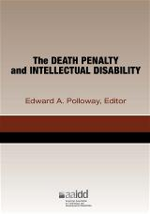
https://aaidd.org/publications/bookstore-home/product-listing/the-death-penalty-and-intellectual-disability#.WHkDB_krLIU
Polloway, E. (Ed.) (2015). The death
penalty and intellectual Disability.
Washington, D.C.: American Association on
Intellectual and Developmental Disabilities.
ISBN 978-1-937604-13-4. Member price:
$33.95. Nonmember price: $39.95.

Slide 14
"This book is the authoritative resource on the application of diagnostic information concerning intellectual disability (ID) in death penalty cases. In a landmark decision in Atkins v. Virginia in 2002, the Supreme Court ruled that executing someone with ID is a violation of the Eighth Amendment of the U.S. Constitution, which prohibits cruel and unusual punishment. In its 2014 decision, Hall v. Florida, the Court ruled that, while states have the right to establish their own rules for handling Atkins cases, they cannot ignore scientific and medical consensus regarding intelligence and the nature and diagnosis of ID. The Court rejected the use of an IQ test score of 70 as a bright-line cutoff for determining ID and rules that all evidence pertinent to the claim, including adaptive behavior assessments, should be considered.

Slide 15
"This publication provides a comprehensive and cogent resource for the use of the range of professionals involved in the determination process for intellectual disability within the criminal justice system. The following are among the critical topics addressed: foundational considerations, including diagnostic criteria, the definition of ID, the analyses of Atkins cases; assessment considerations; intellectual functioning, including IQ testing and the Flynn effect; adaptive behavior; and related topics, such as cultural and linguistic factors, competence to waive Miranda rights and to stand trial, retrospective diagnosis, malingering, comorbid disorders, educational records, and professional issues."

