Slide 1
Some Statistical Information Regarding the Feifer Assessment of Reading (FAR) by Steven G. Feifer (Lutz, FL: PAR, 2015). https://www.parinc.com/Products/Pkey/110

Slide 2
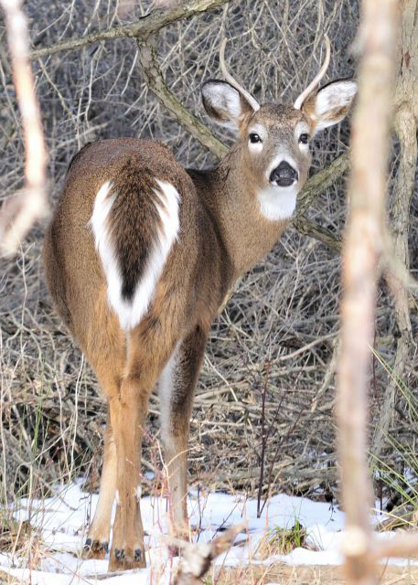
A clinical psychologist, a school psychologist, and a psychological research statistician are out hunting. The clinical psychologist shoots at a deer and misses 5 feet to the left. The school psychologist takes a shot and misses 5 feet to the right. The statistician yells, "We got him!"

Slide 3
https://www.parinc.com/Products/Pkey/110
Professional Manual by Steven G. Feifer, DEd, and Rebecca Gerhardstein Nader, PhD (Lutz, FL: PAR, 2015)
https://www.parinc.com/Resources/Training-Portal
In addition to an interactive course, pronunciation guides for
various FAR subtests are available on the PAR Training Portal.

Slide 4
FAR NORMS
FAR norms are based on grade placement.
A sort of approximately equivalent age [a single year] is listed in parentheses, e.g., Grade 5 (Age 10 years).
The standard score for a raw score remains the same throughout the entire grade.
In the example below, the same raw scores give the same standard scores in September and June!

Slide 5
FAR NORMS

Slide 6
FAR NORMS
Same raw scores 4 months later = same standard scores.

Slide 7
FAR NORMS
Same raw scores 9 months later = same standard scores.

Slide 8
FAR NORMS
Your standard score remains the same for any given raw score from the first day of school to the last day of school.
Most achievement tests have Fall and Spring or Fall, Winter, and Spring norms.
The Woodcock-Johnson has norms for each month of the school year and for each month of age.

Slide 9
FAR NORMS
Most achievement tests have age-based norms as well as grade-based norms. Most have age norms at intervals of less than a year (e.g., 10:0 – 10:3 or 10:0 – 10:6), at least for younger ages.
Each norming system has its own special set of problems.

Slide 10
FAR NORMS
Think carefully when interpreting scores on any test. Neither scores compared to same-age students nor scores compared to same-grade students may tell the whole story.
Consider reporting two separate tables of scores (age- and grade-based), especially if the student has been retained in grade.

Slide 11
FAR NORMS
Always label scores in table titles and in text with modifiers such as "compared to other students in third grade" or "for third grade" or "compared to other students of age 12 years" or "for age 12."
The Professional Manual does permit you to use grade level as a proxy for age, using Figure 4.1 (FAR Professional Manual, p. 95). Again, scores are for whole grade years, not terms, trimesters, or tenths of a year.

Slide 12
FAR NORMS
Figure 4.1 (FAR Professional Manual, p. 95) shows grades vertically on the left and ages horizontally on the bottom with a series of bars showing the mean age (± 1 and 2 SDs) for each grade, so you can draw a vertical line up from the student’s age (in years and months) and select the whole-year grade that best matches the student’s age.

Slide 13
FAR NORMS
Some readers of our evaluation reports have never seen an evaluation report in their lives.
Some have seen many reports and may be reading other reports on their child or student along with our report. Both groups of readers are likely to be confused by contradictory information in different reports.

Slide 14
FAR NORMS
The parent, teacher, or attorney may have just read, for example, that standard scores of 85 to 115 are "Average" on the WIAT-III and that 90 to 110 is "Average" on the WJ IV, and may then read that 90 to 109 is "Average" on the FAR. (The KTEA-3 allows either of two different classification systems for standard scores.)

Slide 15
FAR NORMS
For purposes of reading intervention, many specialists call standard scores of 96 to 109 "on grade level" and 90 to 95 "some risk."
All of these classifications are arbitrary, and must be explained very clearly in evaluation reports!

Slide 16
"Qualitative descriptors are only suggestions and are not evidence-based; alternate terms may be used as appropriate" [emphasis in original]. Wechsler, D. (WISC-V Research Directors, S. E. Raiford & J. A. Holdnack) (2014). Wechsler Intelligence Scale for Children (5th ed.): Technical and Interpretive Manual. Bloomington, MN: Pearson, p. 152.]

Slide 17
Label scores consistently!

Slide 18
110

Slide 19
FAR NORMS
My standard score of 110 (percentile rank 75) is Above Average, High Average, or Average.
At least that much is clear.
There is something to be said for skipping labels and just using percentile ranks.

Slide 20
Suggested Explanations of Percentile Ranks
Mordred’s standard score of 85 was as high as or higher than the scores of 16 percent of students in his grade and lower than the other 84 percent (percentile rank 16).
Mordred scored 80, percentile rank 9 (as high as or higher than 9 percent of students in his grade).

Slide 21
Suggested Explanations of Percentile Ranks
Mordred’s score of 95 was in the 37th
percentile.
Occasionally recycle wording #1 and #2 in case readers forget.
People can use their judgment to decide, for example, whether scoring lower than 84% of fellow students is acceptable.

Slide 22
Percentile Ranks
The problem with percentile ranks is that they are not equal units. They are squished together in the middle and spread out at the ends. We can’t measure progress with them.
We cannot add, subtract, multiply, divide or, therefore, find a mean for percentile ranks. We can find a median or middle score if we enjoy doing that sort of thing.

Slide 23
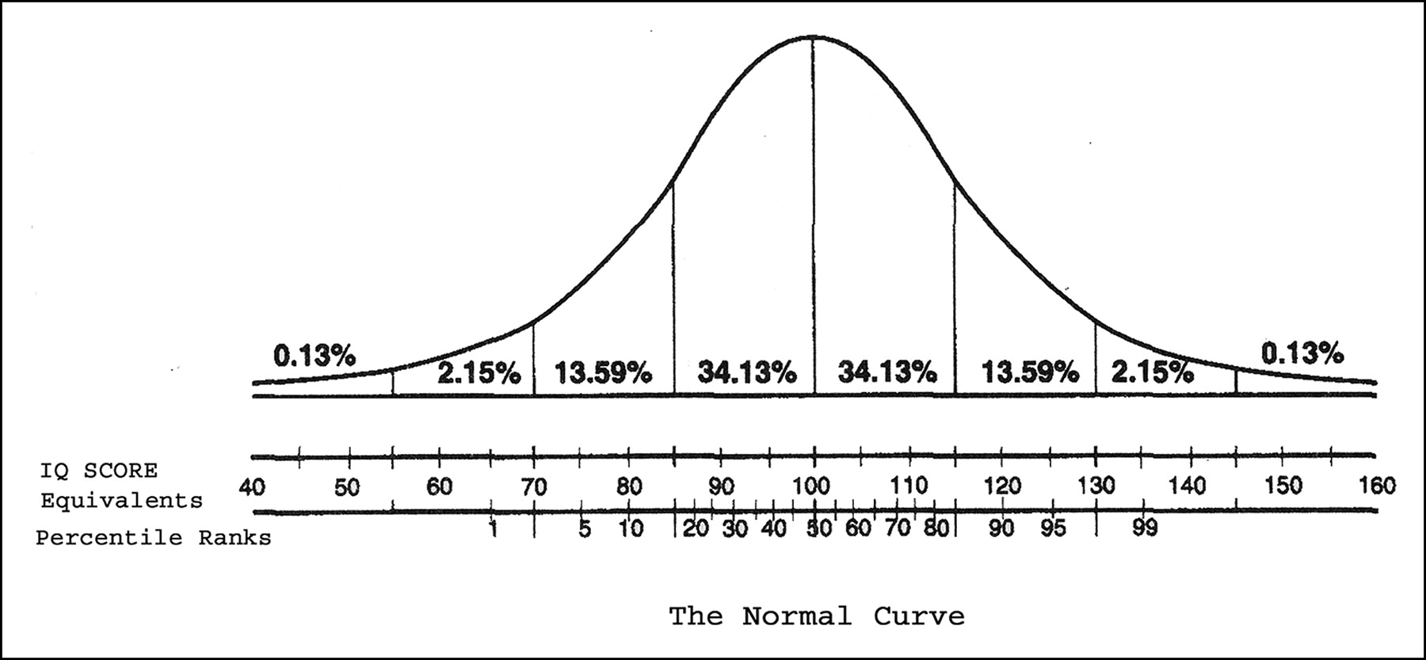
.
Percentiles 1-10 Percentiles 51-60

Slide 24
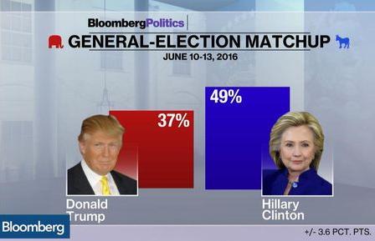
FAR NORMS
Norming samples for tests are like the responders chosen for a political poll.
Norming samples must be truly representative of the entire the the population to be accurate.

Slide 25
FAR NORMS
The FAR reportedly went through extensive development and pilot testing before they normed the final edition. Those steps are essential for deglitching.
The final norms were based on 62 to 70 students in each grade from PK through 12, 71 in grades 13/14, and 63 in grades 15/16, a total of 1,074 students.

Slide 26
FAR NORMS
62 to 70 students in each grade, PK – 12
71 in grades 13/14 (35.5 per grade)
63 in grades 15/16 (31.5 per grade)
Even with continuous norming, we think these are small numbers. We would prefer at least 100 per year, but nobody asked us.

Slide 27
FAR NORMS
The sample was drawn from 31 states and matched the 2012 U.S. Census data reasonably well for gender, ethnicity, parent education, and region. “Weighting” procedures brought the matches even closer.
They used “continuous norming” procedures, which improve the accuracy of the norms.

Slide 28
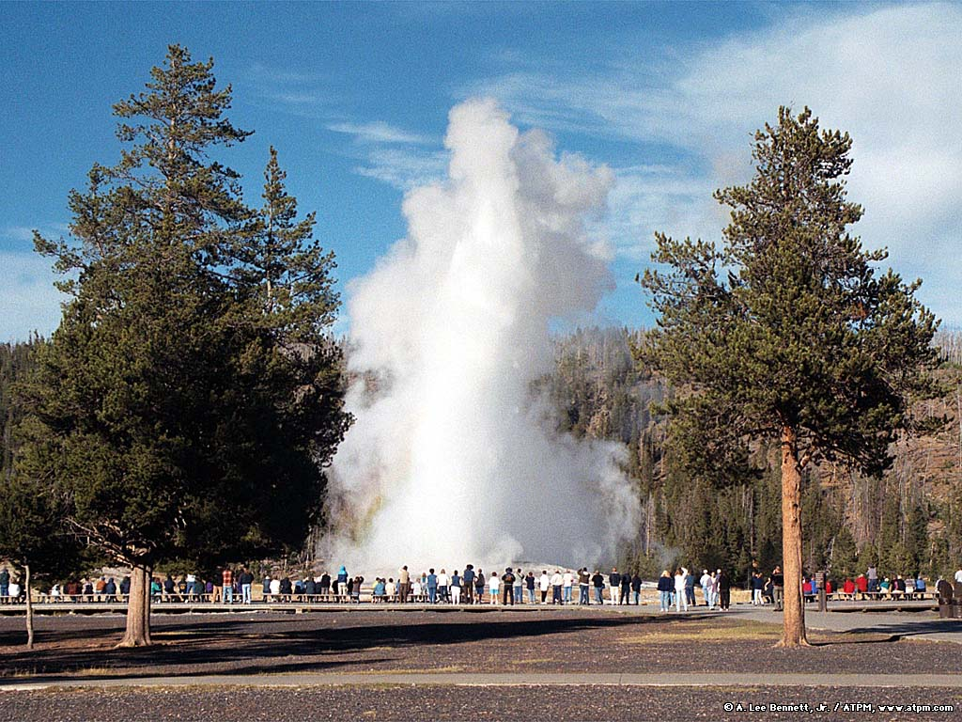
FAR RELIABILITY

Slide 29
FAR RELIABILITY
Reliability is the statistical term for “consistency,” not “trustworthiness.”
.00 - .59 very low or very poor
.60 - .69 low or poor
.70 - .79 moderate or fair
.80 - .89 moderately high or good
.90 - .99 high or excellent
Murphy, K. R., & Davidshofer,
C. O. (2005). Psychological
testing: Principles and
applications (6th ed.). Upper
Saddle River, NJ: Pearson
Education.
> .80 preferred for
individual
assessment
≥ .90 for making
decisions

Slide 30
FAR RELIABILITY
Test reliability is essential. If a test cannot even be consistent with itself, it certainly cannot measure anything else.
A test cannot be valid for any purpose without being reliable. However, a test can be reliable without being valid for a particular purpose, or even any purpose.

Slide 31
Correlation
Psychologists used to believe that brain size, as estimated from head circumference, was a valid measure of intelligence. Adult head circumfer-ence is normally a very reliable measure and it predicted that men were smarter than women. Male psychologists were very disappointed eventually to discover that it turned out not to be correlated with IQ. Reliable, but not valid.

Slide 33
Correlation
The following scatter plots illustrate various levels of correlations between two variables. With a correlation of .90, there is an obviously strong relationship between the two variables. If you knew the score on one variable, you would be able to predict the score on the second fairly accurately.

Slide 35
With a correlation of .60, there is still a relationship, but your predictions of scores on one variable from scores on another would be much weaker. When the correlation drops to .30, the upper left and lower right corners are still empty (extremely high scores on one variable are not associated with extremely low scores on the other), but that is about all you have.

Slide 36
At r = .10, there is almost no relationship at all. Keep the following pictures in mind as you consider correlation values in research reports and test manuals. A Correlation Coefficient of 1.00 indicates a "perfect" relationship. With a Correlation Coefficient of 1.00, knowledge of an individual's score on one test allows exact prediction of the individual's score on the other test.

Slide 37
A Correlation Coefficient of 0.00 indicates no relationship at all. One might just as well guess the second score with dice. A statistically significant correlation, or one that is too high to be likely to occur by pure chance (p < .05, p < .01, etc.), does not necessarily mean that the correlation is high enough to make very useful predictions, just that it is greater than chance.

Slide 39
Note that, although the QAT and ZAT are highly correlated (.93), the mean ZAT score (108.8) is 20 points higher than the mean QAT score (88.7)! If this difference were demonstrated in a large, random sample, then any particular score would not indicate the same level of performance on the two tests.

Slide 40
Correlation
There are several ways of measuring reliability, including:
Internal consistency, e.g., correlation between partial scores based on odd- and on even-numbered items, and
Stability, or correlation between scores of a group on two administrations of the test.

Slide 41
Correlation
In case you were wondering, the correlation coefficient tells us how much of the variance of the predicted scores can be accounted for by the predictor scores.
You just square the correlation coefficient (multiply it by itself).

Slide 42
Correlation

Slide 43
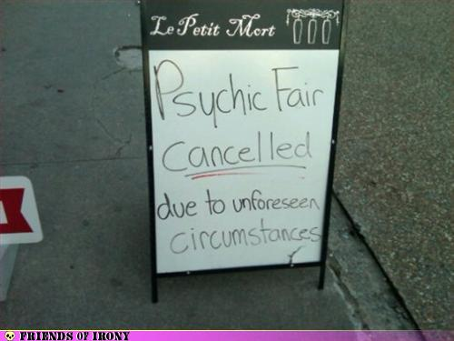
Prediction

Slide 47
FAR VALIDITY
Validity of a test is the accuracy with which it measures whatever it purports to measure.
Validity is measured for a specific purpose; it does not exist by itself.
The FAR Professional Manual offers a good deal of evidence regarding validity.

Slide 48
FAR VALIDITY
FAR raw scores correlate with grade level at .76 or higher except for NWD and VP.
Correlations are provided between the FAR and Process Assessment of the Learner (PAL-II), Gray Silent Reading Test (GSRT), Gray Oral Reading Test (GORT-5), Academic Achievement Battery (AAB), Child and Adolescent Memory Profile (ChAMP), and Reynolds Intellectual Assessment Scales (RIAS-2).

Slide 49
FAR VALIDITY
Based on scores of 33 students (not a big sample), correlations between the FAR and the PAL-II are mixed, partly because the PAL-II is a complex test with many unusual subtest formats. For the most part, correlations were higher between the FAR and PAL-II subtests with similar content.

Slide 50
FAR VALIDITY
"Interestingly, the FAR Morphological Processing subtest was only moderately correlated with the PAL-II Reading and Writing Morphological Decoding Accuracy subtest (r = .35), suggesting that the FAR's ability to measure morphological word completion taps into a more unique skill than merely reading a complete word list" (Professional Manual, p. 102).

Slide 51
FAR VALIDITY
LESSONS:
Never trust subtest names (e.g., the RIAS has a subtest named "Guess What").
Subtle differences in content, format, and administration can greatly affect scores.
It is possible, after all, for one thing to be "more unique" than another.

Slide 52
FAR VALIDITY
FAR Irregular Word Reading Fluency was correlated r = .76 with PAL-II Orthographic Coding Composite (.76² = 56% overlap).
FAR Isolated Word Reading Fluency was correlated r = .75 with PAL-II Morphological Decoding Fluency (.75² = 58% overlap).

Slide 53
FAR VALIDITY
FAR Positioning Sounds was correlated r = .74 with PAL-II Reading and Writing Phonemes (.74² = 55% overlap).
FAR Phonemic Awareness was correlated r = .65 with PAL-II Reading and Writing Phonemes (.65² = 42% overlap).

Slide 54
FAR VALIDITY
FAR Rapid Automatic Naming correlation with PAL-II Rapid Automatic Naming Composite was only r = .04! (.04² = 0.16% overlap). They use different types of symbols.
However, FAR Isolated Word Reading Fluency had r = .68 with PAL-II Rapid Automatic Naming Composite. (.68² = 46% overlap).

Slide 55
?
? = I would have expected a significant correlation.
?
?
?

Slide 56
FAR VALIDITY
The correlations are based on the scores of 25 students (definitely not a big group).
FAR Phonemic Awareness, RAN, Verbal Fluency, Visual Perception, Orthographical Processing, and Word Recall had no significant correlations with any of the Gray subtests or quotients.

Slide 57
FAR VALIDITY
All statistical measurements are subject to some random variation. A "significant" difference, correlation, or other statistic is one too great to occur just by random variation more than a certain proportion of the time.
p ≤ .05 means no more than 5 times in 100.
p ≤ .01 means no more than 1 time in 100.

Slide 58
A Quick Digression
In evaluation reports, we often refer to "significant differences" between scores. The evaluator could include footnotes such as the following.
Scores cannot be perfectly accurate on even the best tests. Lucky and unlucky guesses, barely beating or missing a time limit, and other random factors influence test scores.

Slide 59
Digression
In this report, a "significant difference" is one too great to occur just by random variation more than 5 times in 100.
Even significant differences may not be uncommon. In this report, an "uncommon difference" is one so great that it is not seen in more than 10 percent of examinees.

Slide 60
Digression
Footnotes

Slide 61
Digression
Most readers ignore these (and other footnotes, such as "Your Kindle is about to explode."), but the footnotes are there for those who want to know.
The evaluator might write "in this report," because the choice of cut-offs for significance and uncommonness is, within reason, arbitrary.

Slide 62
FAR VALIDITY: ACHIEVEMENT TESTS
In a study with 109 students, all FAR Index scores had significant correlations with all Academic Achievement Battery (AAB) composite scores, including Mathematical Calculation and Reasoning.
The mean FAR Total Index was 99.0 and the mean AAB Total Achievement was 99.5.

Slide 63
FAR VALIDITY: ACHIEVEMENT TESTS
Correlations of FAR index scores with AAB Basic Reading and Reading Comprehension composites were .39 to .64, median .59.
Correlations of FAR index scores with AAB Listening Comprehension and Expressive Communication composites were .22 to .51, median .44.

Slide 64
FAR VALIDITY: ACHIEVEMENT TESTS
Correlations of FAR index scores with the AAB Written Expression composite were .47 to .61, median .58.
Correlations of FAR index scores with the AAB Mathematical Calculation composite were .24 to .35, median .33.

Slide 65
FAR VALIDITY: ACHIEVEMENT TESTS
Correlations of FAR index scores with the AAB Mathematical Reasoning composite were .23 to .53, median .46.
Correlations of FAR index scores with the AAB Total Achievement composite were .46 to .71, median .69.
Correlation of FAR Comprehension Index with the AAB Basic Reading and Reading Comprehension index scores were, respectively, .39 and .40.

Slide 66
FAR VALIDITY: MEMORY TESTS
Correlations of 129 students' FAR subtest scores with the Child and Adolescent Memory Profile (ChAMP) were generally low, although some were statistically significant.
The higher of the low correlations make sense, such as RAN, Verbal Fluency, and Word Recall with the ChAMP Lists and Lists Delayed. (Print Knowledge correlations were inflated by the narrow grade range [PK – 1] in case you're keeping score.)

Slide 67
FAR VALIDITY: INTELLIGENCE TESTS
Correlations, for 144 students, of FAR index scores with the Reynolds Intellectual Assessment Scales (RIAS-2) Composite Index were .33 to .52, median .46.
The mean FAR Total Index was 98.5 and the mean RIAS-2 Composite Index was 101.5. Close enough for government work.

Slide 68
FAR VALIDITY

Slide 69
FAR VALIDITY
Correlations, especially for Comprehension, are higher with verbal than with nonverbal intelligence on the RIAS-2.
The Fluency correlations make sense.
The FAR Total Composite and RIAS-2 Composite are correlated .48 (23% overlap), so 77% of variance on the FAR total must be accounted for by variables other than IQ.

Slide 70
FAR VALIDITY
That 78% might include measurement error, quality of reading instruction, number of books in the home, number of words spoken to the child, hours of screen time, dyslexia, other disabilities, and other factors. The correlation of .48 looks pretty reasonable.

Slide 71
FAR VALIDITY
The Professional Manual includes scores of samples of students diagnosed with IDD (28), ADHD (36), and LD (59) compared with matched control groups, whose index scores were close to 100.
For the IDD group, the mean Total was 52. All subtest means were < 70, except VP (79), WR (75), SRF-R (72).

Slide 72
FAR VALIDITY
For the ADHD group, the mean Total was 95. All subtest means were between 91 and 100.
The students in the LD group had a Total score of 61 with subtests between 63 and 88.

Slide 74
FAR VALIDITY
If we use cut-off scores to diagnose a condition or disability, we will make two kinds of errors:
False Positive: person without the disability is diagnosed as having it.
False Negative: person with the disability is not diagnosed as having it.

Slide 75
FAR VALIDITY
We can adjust the cutoff to alter the balance of false positives and false negatives. If, for instance, I decide that the cutoff for a diagnosis of dyslexia is a reading standard score of 160, I will not have many false negatives, but an awful lot of false positives.

Slide 76
FAR VALIDITY
These decisions are value judgments based on the costs of false positives and negatives.
For instance, a false negative test for a lethal, but curable, disease is disastrous.
However, a false positive for a terrifying disease that requires a painful and debilitating treatment is not good, either.

Slide 77
FAR VALIDITY
The FAR Professional Manual authors tell us, “These results indicate that an optimal cutoff score for the FAR Total Index is in the low- to mid-70s. . . . Several potential cutoff scores were identified. . . . The user can consider this information when choosing the cutoff score [to] use to identify individuals with a potential learning disability” (p. 112).

Slide 78
FAR Validity

Slide 81
Note
It is only a coincidence that the Sensitivity and Positive Predictive Power are the same (0.678) and that the Specificity and Negative Predictive Power are the same (0.982) in this example. Because of the chosen cut-off, there just happen to be 19 false positives and also 19 false negatives.
Sensitivity = (True Positive)/(True Positive + False Negative)
Specificity = (True Negative)/(True Negative + False Positive)
Positive Predictive Power = (True Positive)/(True Positive + False Positive)
Negative Predictive Power = (True Negative)/(True Negative + False Negative)
False Positive = (False Positive)/(True Positive and False Positive)
False Negative = (False Negative)/(True Negative and False Negative)

Slide 82
FAR VALIDITY
With any test, if you use a higher cut-off score, you will identify more examinees as having a learning disability, but that will include more falsely identified students who had no disability (false positive).
If you use a lower cut-off score, you will identify more examinees as not having a learning disability (LD), but that will include more falsely non-identified students who actually did have a learning disability (false negative).

Slide 83
Lowest Possible FAR Subtest Standard Scores (Raw Score = 0)
Scores above the first percentile (lowest 1% of all scores) are in red.
Grade | PA | NWD | ISO | ORF | PS | RAN | VF | VP | IRR | OP | SC | WR | PK | MP | SRF-C | SRF-R
PK | 70 |  |  |  | 85 | 70 | 70 | 70 |  |  | 75 | 70 | 70
K | 58 |  | 70 | 70 | 70 | 57 | 66 | 69 |  | 75 | 70 | 67 | 50
1 | 50 |  | 58 | 64 | 60 | 50 | 62 | 69 |  | 64 | 66 | 63 | 50
2 | 50 | 75 | 57 | 60 | 50 | 50 | 57 | 68 | 70 | 62 | 52 | 57 |  | 70 |  | 65
3 | 50 | 72 | 50 | 55 | 50 | 50 | 52 | 68 | 63 | 59 | 50 | 50 |  | 68 | 65 | 63
4 | 50 | 68 | 51 | 50 | 50 | 50 | 50 | 64 | 54 | 50 | 50 | 50 |  | 65 | 66 | 55
5 | 50 | 61 | 50 | 50 | 50 | 50 | 50 | 50 | 50 | 50 | 50 | 50 |  | 62 | 57 | 50
By fifth grade (age 10 years), a child who makes no response at all will score in the lowest one percent of same-grade and same-age students on all FAR subtests. In PK, a totally unresponsive child's scores would range from 70 (percentile rank 2) to 85 (percentile rank 16). A totally unresponsive Kindergartener would have scores from 50 (percentile rank 0.1) to 75 (percentile rank 5).

Slide 84
Highest Possible FAR Subtest Standard Scores (Perfect Raw Score)
Scores below the 99th percentile (highest 1% of all scores) are in red.
Grade | PA | NWD | ISO | ORF | PS | RAN | VF | VP | IRR | OP | SC | WR | MP | SRF-C | SRF-R
15-16 | 120 | 120 | 130 | 150 | 120 | 130 | 150 | 141 | 130 | 120 | 139 | 143 | 130 | 148 | 150
13-14 | 120 | 120 | 131 | 150 | 120 | 130 | 150 | 141 | 131 | 120 | 147 | 143 | 132 | 150 | 150
12 | 121 | 121 | 135 | 150 | 120 | 131 | 150 | 141 | 132 | 120 | 148 | 144 | 137 | 150 | 150
11 | 121 | 122 | 140 | 150 | 120 | 132 | 150 | 142 | 134 | 123 | 150 | 144 | 141 | 150 | 150
10 | 122 | 124 | 150 | 150 | 121 | 134 | 150 | 143 | 137 | 127 | 150 | 144 | 142 | 140 | 150
9 | 125 | 126 | 150 | 150 | 122 | 137 | 150 | 145 | 141 | 128 | 150 | 145 | 150 | 150 | 150
8 | 127 | 129 | 150 | 150 | 128 | 141 | 150 | 146 | 146 | 131 | 150 | 146 | 150 | 142 | 150
7 | 129 | 133 | 150 | 150 | 131 | 146 | 150 | 148 | 150 | 136 | 150 | 150 | 150 | 143 | 150
6 | 133 | 137 | 150 | 150 | 135 | 150 | 150 | 150 | 150 | 143 | 150 | 150 | 150 | 143 | 150
In sixth grade (age 11 years), a child who earns the highest possible raw score (no errors at all or greatest measured speed) will score in the highest one percent of same-grade and same-age students on all FAR subtests. In 12th grade, a perfect raw score would range from 120 (percentile rank 91) to 150 (percentile rank 99.9).

Slide 85
Reliable Score Changes
Appendix H of the FAR Professional Manual provides tables to determine whether changes in test scores are statistically significant (too large to be likely to have occurred just by random variation).
The tables do not appear to take into account the span of time or the times of year for first and second tests.
Values are given for probabilities of less than .01 or .05 (1 or 5 chances in 100), but also .10 and .15, which we would not recommend considering significant.

Slide 86
Reliable Change Scores
Libertine Liberal Conservative
Libertarian Moderate

Slide 87
Skills and Error Analyses
Examiners spend too much time testing and too little analyzing.
The FAR offers Skills and Error Analyses forms in Appendix I.
Unfortunately, these analyses are not normed, but they are useful.
They compare categories within subtests (e.g., % correct for Synonyms vs. Antonyms)
and same items on two subtests (e.g., target word on ISO vs. ORF).
A few examples follow.

Slide 88
Skills and Error Analyses
This is what the authors call the optional Level 5 of interpretation.
"An error analysis identifies the types of miscues the examinee tends to make during the reading process. Being aware of consistent error patterns is extremely useful for intervention planning and decision making. For instance, if an examinee consistently has difficulty with medical vowel positions in words, targeted interventions can be applied directly at fostering this particular skill" (p. 74).

Slide 89
Skills and Error Analyses
Maximum number of phonemic blends and segmentations helps determine phonological working memory capacity, important for planning interventions.
Phonological categories help differentiate between basic skills, such as Rhyming and Blending, and advanced Manipulation skills.
Maximum number of syllables in a single Nonsense Word helps estimate phonological working memory capacity.

Slide 90
Skills and Error Analyses
On Oral Reading Fluency, examiners can compare rate and accuracy.
Comparing Oral Reading Fluency and Isolated Word Reading Fluency allows the obvious contrast.
Verbal Fluency. "If repetitions are far apart in proximity, a working memory deficit may be present. If repetitions are close together or consecutive, a true perseverative error has occurred [which] generally reflect rigid and inflexible thinking" (p. 75).

Slide 91
Skills and Error Analyses
There are similar grade-level error analyses for:
RAN (shown on previous slide)
Verbal Fluency
Visual Perception
Word Recall Repetitions
Word Recall Intrusions

Slide 92
Skills and Error Analyses
Positioning Sounds
Long Vowel • Short Vowel
R-controlled Vowel • Diphthong
Digraph • Schwa
Blend/cluster
Morphological Processing
Prefix
Root
Suffix
Infix

